Slide 1

4. Computer Networks and Internet
Subtitle
Notes:
NOTE:
To change the image on this slide, select the picture and delete it. Then click the Pictures icon in the placeholder to insert your own image.

Slide 2
Content
4.1 Overview
LAN & WAN
TCP/IP protocol
4.2 Layers in netwoking

Slide 3
Objectives
After studying this chapter, the student should be able to:
Describe local and wide area networks (LANs and WANs).
Distinguish an Internet from the Internet.
Describe the TCP/IP protocol suite as the network model in the Internet.
Define the layers in the TCP/IP protocol suite and their relationship.
Describe the applications in the Internet.
Describe the different transmission media used in computer networking.
Notes:
Protocol suite : bộ giao thức TCP/IP , Network: mạng máy tính , Layers : tầng , Tranmission media : phương tiện truyền dẫn

Slide 4
1-Overview

Slide 5
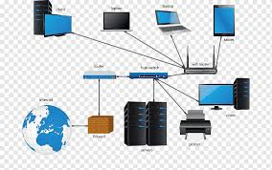
1. Introduction
A network is defined as the interconnection of a set of devices capable of communication.
A device can be a host (or an end system) such as a large computer, desktop, laptop, workstation, cellular phone, or security system.
A device cab be also be a connecting device such as a router which connects the network to other networks, a switch which connects devices together, a modem that changes the form of data, and so on.
These devices in a network are connected using wired or wireless transmission media such as cable or air. Networks
Figure 4.1 A simple network today
Notes:
-liên kết của 1 loạt thiết bị có khả năng giao tiếp với nhau
Host : một máy tính bất kì kết nối với mạng máy tính có địa chỉ xác định ( máy chủ , tổ chức )
Work station: máy trạm , Cellular = Cell phone ,. Cabinet ( Cab ) : Một tệp lưu trữ hỗ trợ nén dữ liệu , Router: bộ định tuyến
Switch : bộ chuyển mạch , Modem : thiết bị ngoại vi điều chế song tín hiệu

Slide 6
2. Local Area Network (LAN)
A LAN is usually privately owned and connects some hosts in a single office, building, or campus.
A LAN can be as simple as two PCs and a printer in someone’s home office, or it can extend throughout a company and include audio and video devices.
Each host in a LAN has an identifier, an address, that uniquely defines the host in the LAN.
A packet sent by a host to another host carries both the source host’s and the destination host’s addresses.
Figure 4.2 A LAN architecture

Slide 7
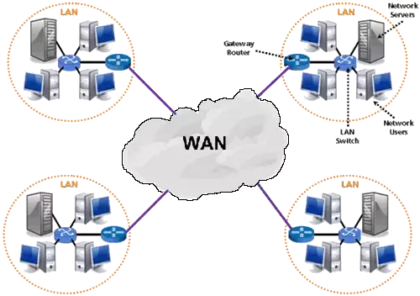
3. Wide Area Network (WAN)
A WAN is also an interconnection of devices capable of communication.
A WAN has a wider geographical span, spanning a town, a state, a country, or even the world, however, a LAN is normally limited in size, spanning an office, a building, or a campus.
A WAN interconnects connecting devices such as switches, routers, or modems, however, a LAN interconnects hosts.
A WAN is normally created and run by communication companies and leased by an organization that uses it, however, a LAN is normally privately owned by the organization that uses it.
Figure 4.3 A WAN architecture

Slide 8
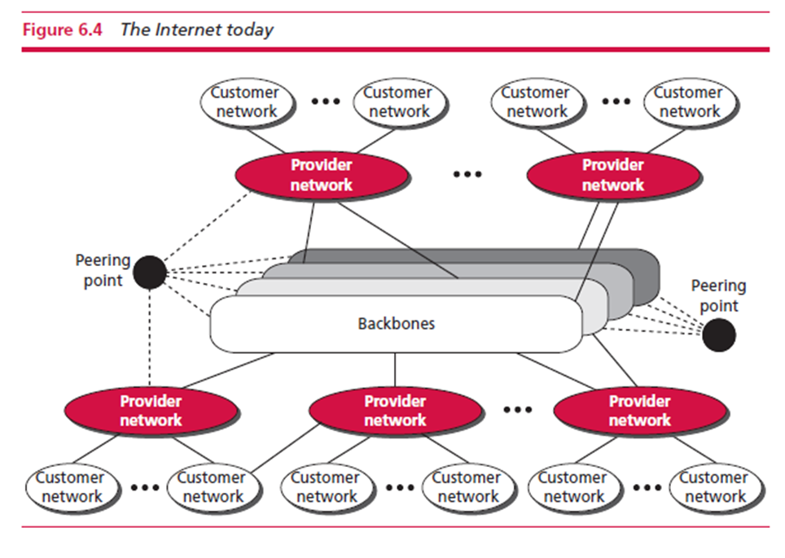
4. The Internet
An Internet is two or more networks that can communicate with each other and is composed of thousands of interconnected networks.
The Internet is as several backbones, provider networks, and customer networks. Backbones at top level are large networks owned by some communication companies. Provider networks at second level use the services of the backbones for a fee.
Customer networks are networks at the edge of the Internet that actually use the services provided by the Internet. They pay fees to provider networks for receiving services. Backbones and provider networks are also called Internet Service Providers (ISPs). The backbones are often referred to as international ISPs.
Figure 4.4 The internet today

Slide 9
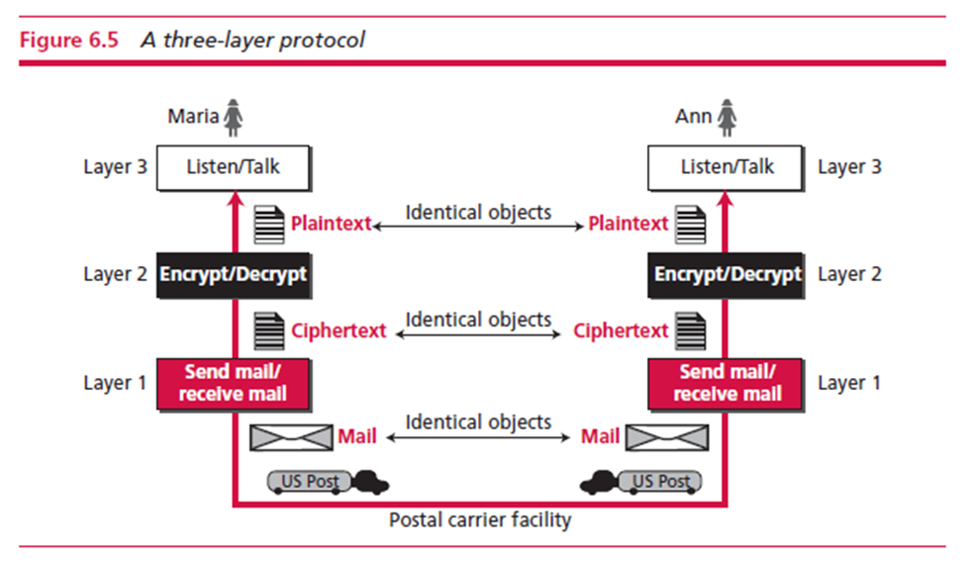
5. TCP/IP
Protocol Layering A protocol defines the rules that both the sender and receiver and all intermediate devices need to follow to be able to communicate effectively in Internet. we need a protocol at each layer, or protocol layering.
Figure 4.5 A three layer protocol

Slide 10
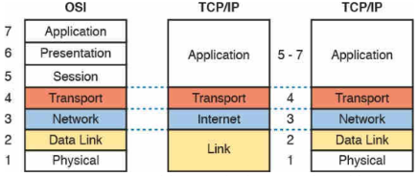
TCP/IP Protocol Suite
The TCP/IP (Transmission Control Protocol / Internet Protocol) is a protocol suite (a set of protocols organized in different layers) used in the Internet today.
It is a hierarchical protocol made up of interactive modules, each of which provides a specific functionality.
Figure 4.6 Layers in TCP/IP Protocol Suite
Notes:
TCP/IP và OSI là 2 giao thức mạng truyền thông phổ biến nhất hiện nay.
+ TCP/IP : dung để thiết lập các liên kết và giao tiếp trong mạng.
+ OSI : mô hình khái niệm, ko đc sử dụng thực tế. OSI xác định cách các ứng dụng có thể giao tiếp qua mạng

Slide 11
Addressing and Packet Names
Any communication that involves two parties needs source and destination addresses. we normally have only four because the physical layer (data exchange is a bit) does not need addresses.
There is a relationship between the layer, the address used in that layer, and the packet name at that layer.

Slide 12
2 - Layers in netwoking
Notes:
Layers: gồm 5 tầng
Thứ tự từ dưới lên là : 5. Tầng ứng dụng

Slide 13
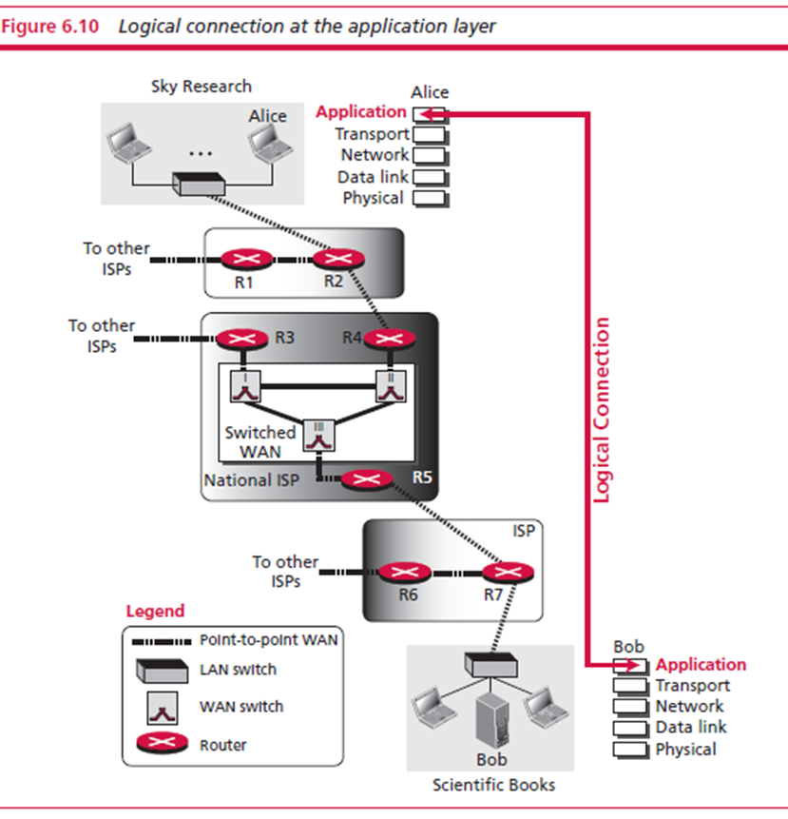
2.1 Application layer
We start from the fifth layer and move to the first layer.
The fifth layer of the TCP/IP protocol is called the application layer.
The application layer provides services to the user. Communication is provided using a logical connection.
Figure 4.7 Logical Connection at Application Layer
Notes:
Tầng 5: Ứng dụng
Đường kết nối “ tượng trưng “ – logic connection ( không phải kết nối bằng dây )

Slide 14
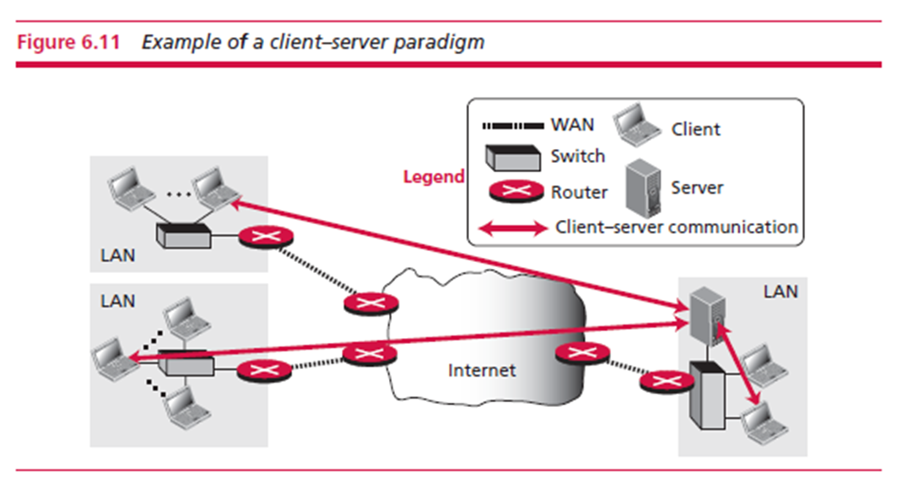
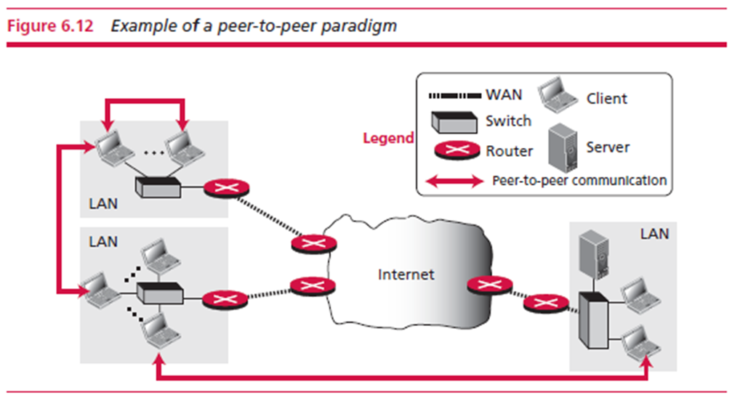
Application-Layer Paradigms
Using the Internet, we need two application programs to interact with each other: one running on a computer and the other running on another. Should both application programs be able to request services and/or provide services?
Two paradigms have been developed during the lifetime of the Internet to answer this question: the client-server paradigm and the peer-to-peer paradigm
Figure 4.8 the client-server paradigm and the peer-to-peer paradigm
Notes:
Client server paradigm : mô hình máy chủ máy khách
Peer – to – peer paradigm :

Slide 15
Applications of Standard Client-Server
Several traditional services are still using this paradigm, including the World Wide Web (WWW) and its vehicle HyperText Transfer Protocol (HTTP), file transfer protocol (FTP), secure shell (SSH), email, and so on.
Figure 4.9 Several traditional services at Application Layer

Slide 16
DNS in the Internet
DNS is a protocol that can be used in different platforms. The domain name space (tree) was originally divided into three different sections: generic domains, country domains, and the inverse domain. However, the inverse domains are now deprecated.
Generic Domains : define registered hosts
Notes:
Domain name ( tên miền )

Slide 17
2.2 TRANSPORT LAYER
The transport layer in the TCP/IP suite is located between the application layer and the network layer. It provides services to the application layer and receives services from the network layer.
The transport layer acts as a liaison between a client program and a server program.
Figure 4.10 Logical Connection at Transport Layer
Notes:
Liaison : liên lạc

Slide 18
Process-to-Process Communication
The Transport-layer protocol provides process-to-process communication . A process is an application-layer entity (running program) that uses the services of the transport layer.
The network layer is responsible for communication at the computer level and can deliver the message only to the destination computer. A transport-layer protocol is responsible for delivery of the message to the appropriate process.
Figure 4.11 Network Layer versus Transport Layer

Slide 19
Addressing: Port Numbers
For communication, we must define the local host (IP), local process, remote host (IP), and remote process. To define the processes, we need second identifiers called port numbers. In the TCP/IP protocol suite, the port numbers are integers between 0 and 65,535 (16 bits).
The client program defines itself with an ephemeral port number that is recommended to be greater than 1023 for some client/server programs to work properly. The server process must also define itself with a port number.
Figure 4.12 Addressing: Port Numbers
Notes:
Local process: quy trình cục bộ
Port number: số cổng
Ephemeral port number

Slide 20
Translayer-Layer Protocols
The User Datagram Protocol (UDP) is a connectionless, unreliable transport protocol. UDP is a very simple protocol using a minimum of overhead. If a process wants to send a small message and does not care much about reliability, it can use UDP. Sending a small message using UDP takes much less interaction between the sender and receiver than using TCP.
UDP packets, called user datagrams (format as below), have a fixed-size header of 8 byte and the total length needs to be less 65 535 bytes.
Transmission Control Protocol (TCP) is a connection-oriented, reliable protocol. TCP explicitly defines connection establishment, data transfer, and connection teardown phases to provide a connection-oriented service. At the transport layer, TCP groups a number of bytes together into a packet called a segment.
TCP adds a header to each segment (for control purposes) and delivers the segment (format as below) to the network layer for transmission. The segments are encapsulated in an IP datagram and transmitted.
Notes:
2 Giao thức truyền tải :
+ UDP: Giao thức người dùng : ko đáng tin cậy( chỉ truyền mà ko quan tâm có đến đích hay ko)
+ TCP: Tin cậy

Slide 21
2.3 NETWORK LAYER
The network layer in the TCP/IP protocol suite is responsible for the host-to-host delivery of messages.
The network layer accepts a packet from a transport layer, encapsulates the packet in a datagram, and delivers the packet to the data-link layer.
At the destination host , the datagram is de-capsulated, the packet is extracted and delivered to the corresponding transport layer.
Figure 4.13 Communication at Network Layer

Slide 22
Packetizing at Network Layer
Packetizing: encapsulating the payload (data received from upper layer) in a network-layer packet at the source and decapsulating the payload from the network-layer packet at the destination.
1. The source network-layer receives a packet from transport- layer, adds a header that contains source and destination addresses and some other information.
2. The network layer then logically delivers the packet to the network-layer protocol at the destination.
3. The destination host receives the network-layer packet, decapsulate the payload and deliver to the upper-layer protocol.

Slide 23
Network-Layer Protocols
The main protocol is called the Internet Protocol (IP) . IPv4 and IPv6 are in use today.
There are three common notations to show an IP address: binary notation (base 2), dotted-decimal notation (base 256), and hexadecimal notation (base 16).

Slide 24
2.4 DATA-LINK LAYER
The TCP/IP suite does not define any protocol in the data-link layer. This layer is the territories of networks that when connected make up the Internet. These networks, wired or wireless, receive services and provide services to the network layer.
Figure 4.14 Communication at Data-Link Layer
Notes:
Tầng liên kết dữ liệu

Slide 25
Nodes and Links
Communication at the data-link layer is node-to-node .Data unit from one point in the Internet needs to pass through many networks (LANs and WANs) to reach another point. Theses LANs and WANs are connected by routers.
It is customary to refer to the two end hosts and the routers as nodes and the networks in between as links .

Slide 26
Wred LANs：Ethernet
Ethernet LAN was developed in 1970s by Robert Metcalfe and David Boggs. Standard Ethernet (10 Mbps), Fast Ethernet (100 Mbps), Gigabit Ethernet (1 Gbps), and 10 Gigabit Ethernet (10 Gbps).
A frame carries some information such as the source address (48 bits), the destination address (48 bits), the type of data, the actual data, and some other control bits as a guard to help checking the integrity of data during transition.
Figure 4.15 Ethernet LAN and the Frame Format

Slide 27
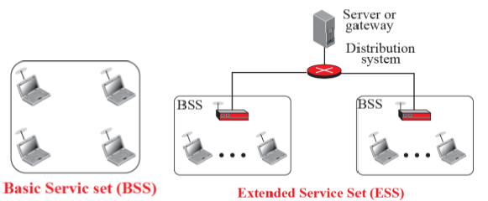
Wireless Ethernet
Wireless Ethernet or WiFi is a wireless LAN. Two kinds of services: the basic service set (BSS) and the extended service set (ESS). The second service uses an extra device (access point or AP) that serves as a switch for connection to other LANs or WANs.
Figure 4.16 the basic service set (BSS) and the extended service set (ESS).

Slide 28
Cable Service
Cable networks were originally created to provide access to TV programs. Cable TV network can also support DSL technology that provides high-data-rate connections for residential subscribers over the local loop.
Figure 4.17 the cable networks of cable service

Slide 29
Wireless WAN:WiMax
The worldwide Interoperability Access (WiMax) is the wireless version of DSL or Cable connection to the Internet. It provide two types of services (fixed WiMax) to connect the main station to fixed station or to mobile stations such as cellular phones
Figure 4.17 The worldwide Interoperability Access (WiMax)

Slide 30
2.5 PHYSICAL LAYER
The role of the physical layer is to transfer the bits received from the data-link layer and convert them to electromagnetic signals for transmission.
After the bits are converted to signals, the signals are delivered to the transmission media.
Figure 4.19 Communication at Physical Layer

Slide 31
Analog and Digital Transmission
Analog Transmission
Digital Transmission
Figure 4.19 Analog and Digital Transmission

Slide 32
Summary of TCP/IP Protocol Layers
Figure 4.20 TCP/IP Protocol Layers

